Slide 1
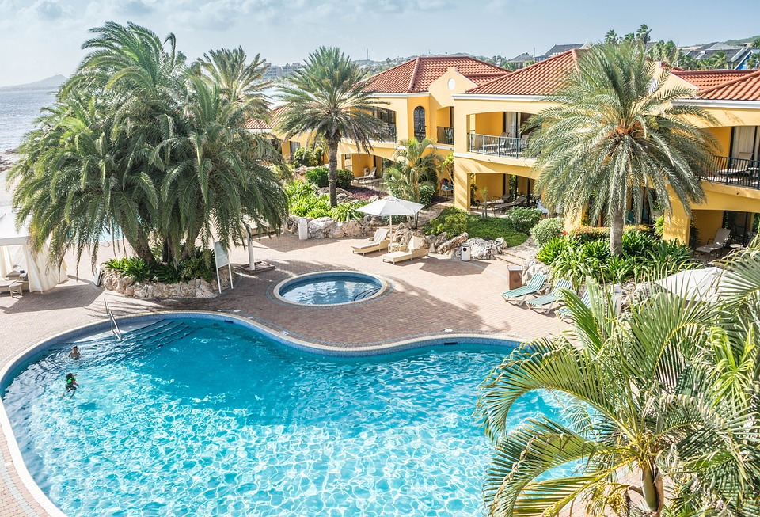

Hotel Booking Report

Slide 2
Business Problem
In city and resort hotel we have seen high cancellation rate. Each hotel is dealing with number of issue as a result including less revenues and less hotel rooms use. we seen this issue in both city hotel and resort hotel, so lowering cancellation rate is primary goal of both the hotel and increase efficiency of generating revenue

Slide 3
Research Question
1. What are the variables that affect hotel reservation cancellation?
2. How can we make hotel reservation cancellation better?
3. How will hotels be assisted in making pricing and promotional decisions?

Slide 4
Hypothesis
1. More cancellations occur when prices are higher.
2. When there is a longer waiting list customers tend to cancel more frequently.
3. The majority of clients are coming offline travel agents to make their reservation.

Slide 5
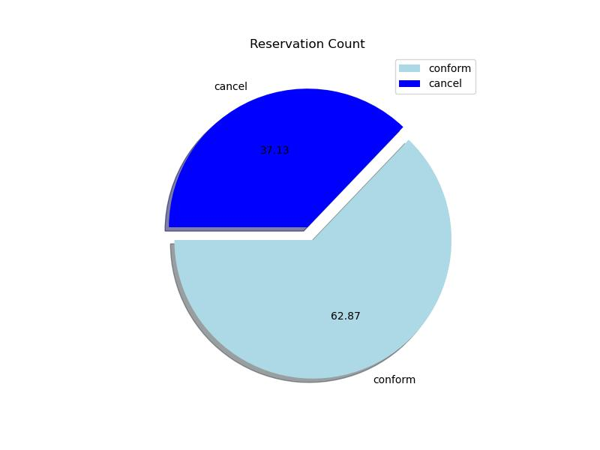
Analysis
Pie chart shows the percentage of reservations that are cancelled and conform.
There are still a significant number of reservation that have not been cancelled but there are still 37% of clients who cancelled their reservation which has a significant impact on hotel’s revenue

Slide 6
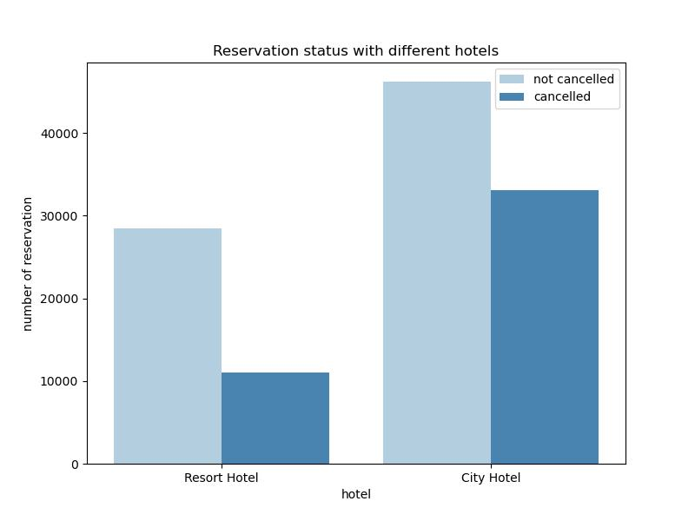
In comparison to resort hotels and city hotels, City hotels have more bookings because they often found in city area and these hotels are not so expensive.
It’s possible that resort hotels are more expensive because of their location and facility they offer.

Slide 7
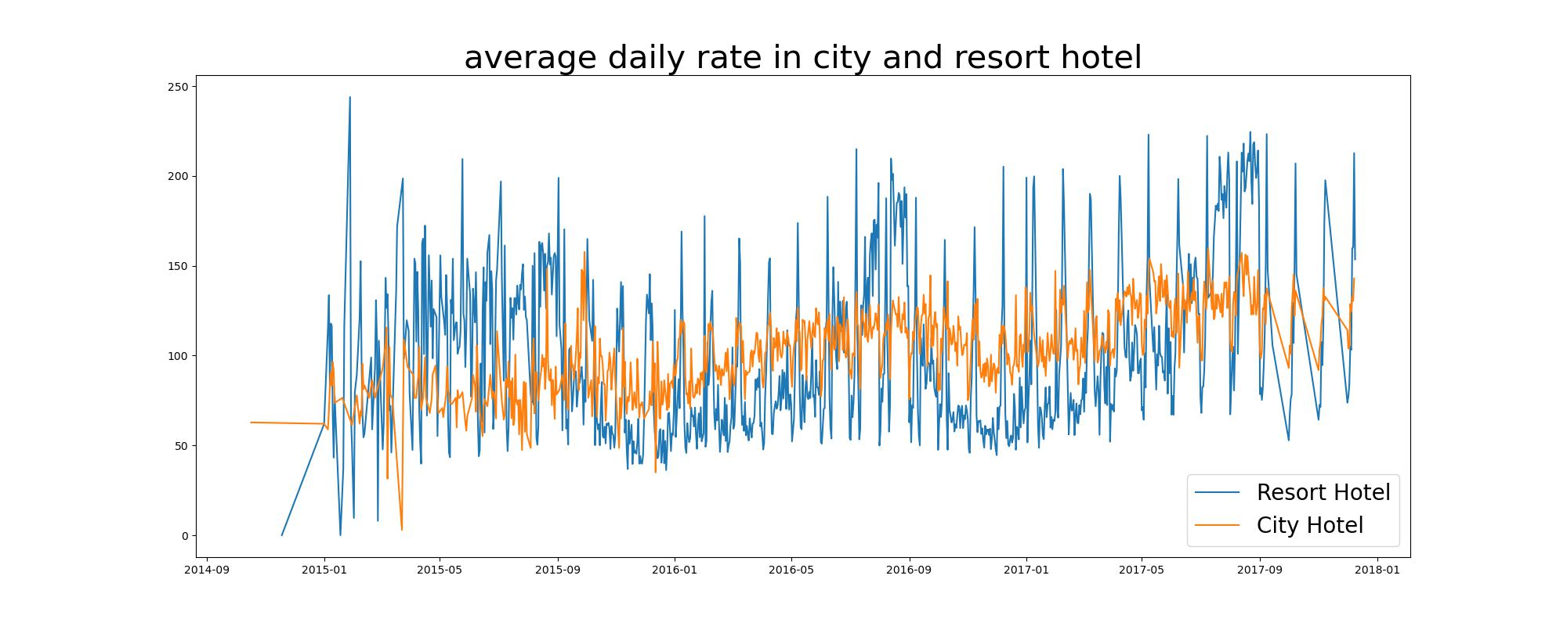
In line graph shows that, on certain days, the average daily rate of a city hotel is less than that of resort hotels and other days it is even less.
It’s clearly shows that weekends and holidays may see a rise in resort hotels rates.

Slide 8
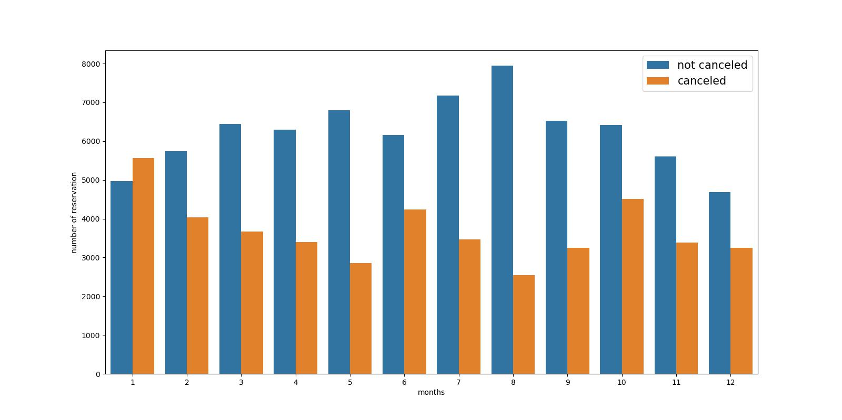
It’s a grouped bar graph to analyse the months with the highest and lowest reservation levels according to reservation status.
Both the number of conform and cancelled reservations are highest in the month of august, where as January is the month with the most cancelled reservations.

Slide 9
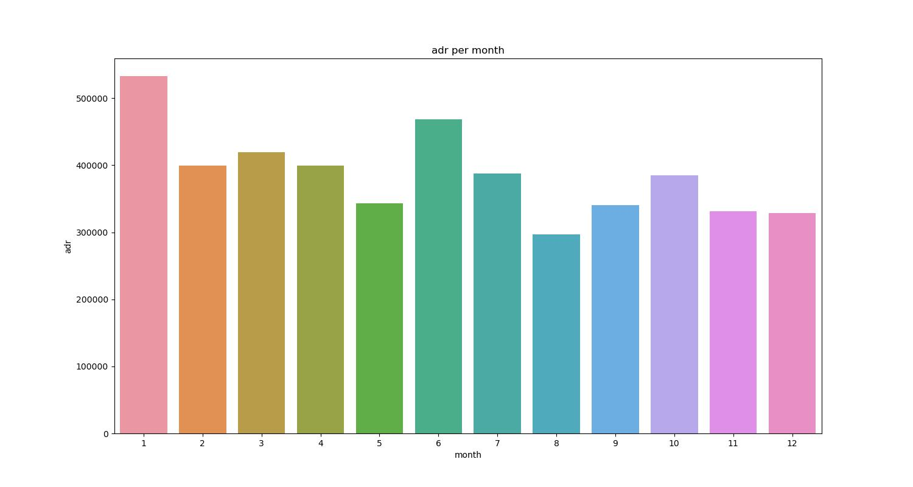
Bar graph shows that cancellations are most common when prices are highest and least common when prices are lowest, therefore cost is responsible for the cancellation.

Slide 10
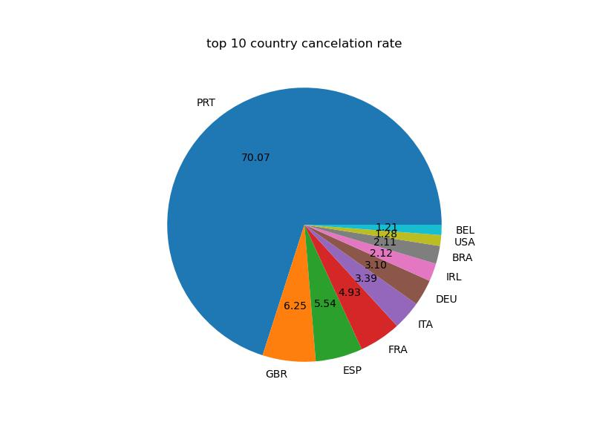
Country wise analysis
Let’s see which country has highest reservation cancelled.
Top country is Portugal with highest number of cancellation which is around 70%

Slide 11
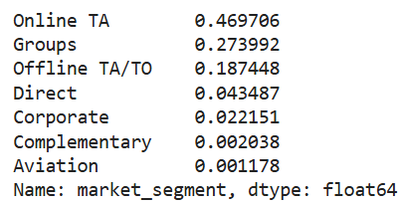
Area where guests are visiting the hotels and making reservations, It is common from direct or groups, online or offline Travel Agents
Around 46% of clients are come from online travel agencies, whereas 27% come from groups and only 4% clients book hotels directly by visiting them and making reservations.

Slide 12
Conclusion or Insights
Cancellation rates rise as price increases, in order to prevent cancellations of reservations, hotels could work on their pricing strategies and try lower the rates of specific hotels based on locations.
They can also provide some discounts to the consumers.
Specially in resort hotels cancellation rate is high so hotels should have reasonable discount on the room prices on weekends and holidays.
In the month of January, hotels can start campaigns or marketing with a reasonable amount to increase their revenue because cancellations is highest in this month.
Mainly target Portugal country to reduce cancellation rate and also increase the quality of their hotels and their services.

